Slide 1
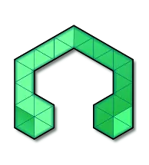
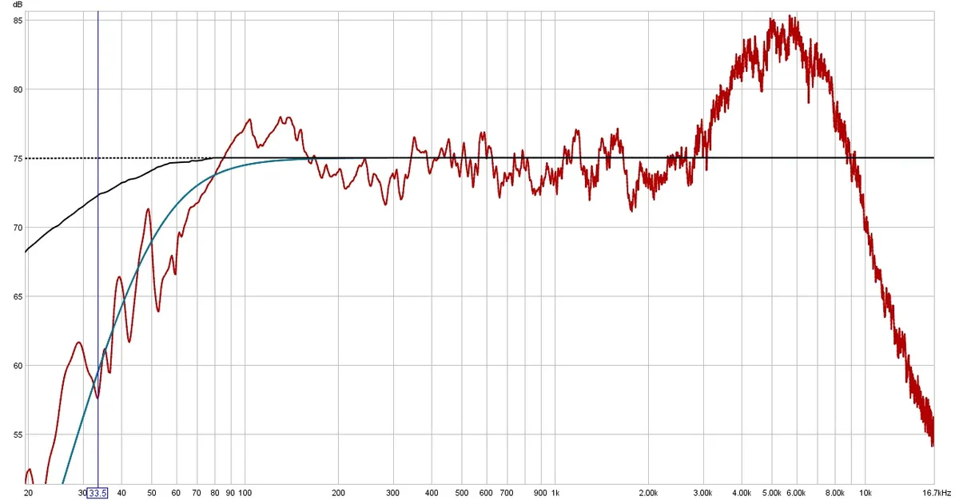
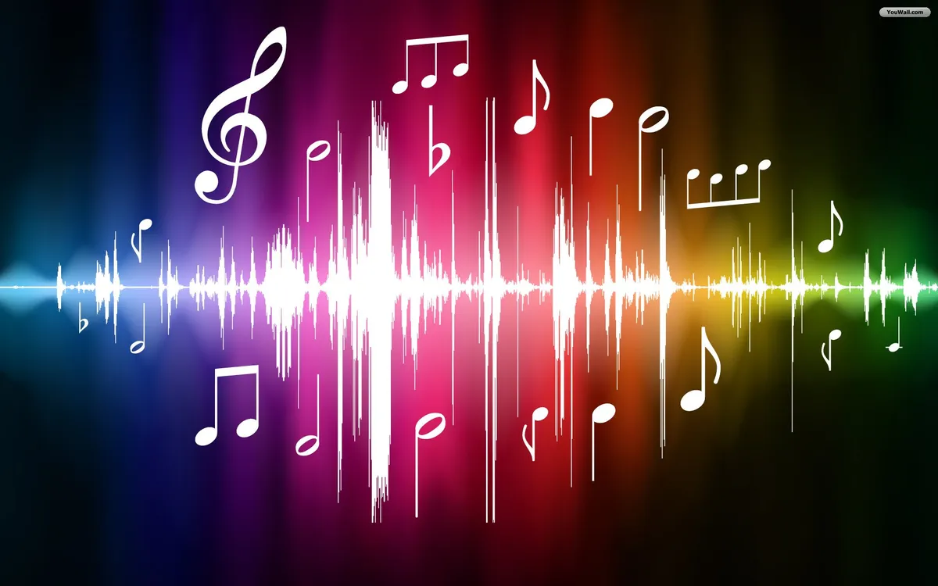
IEEE UCF SKILL SERIES
DIGITAL AUDIO WORKSHOP
January 28, 2023

Slide 2
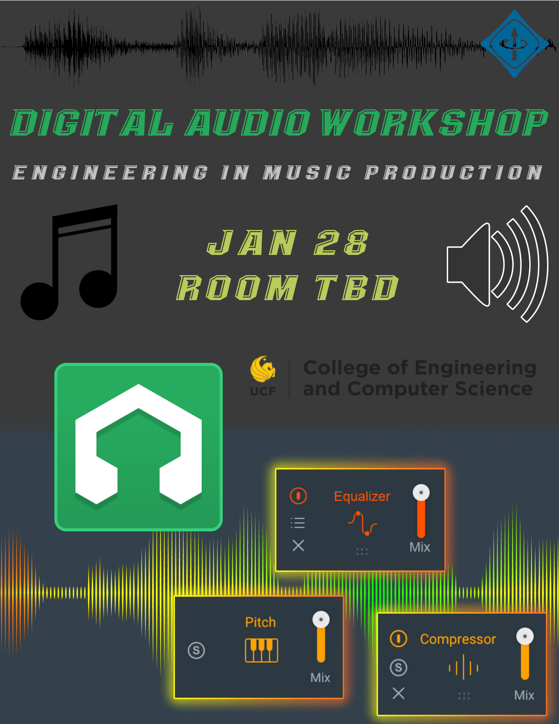

Slide 3
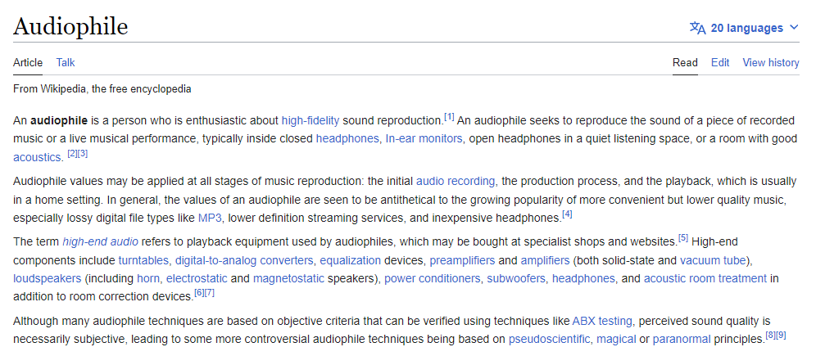
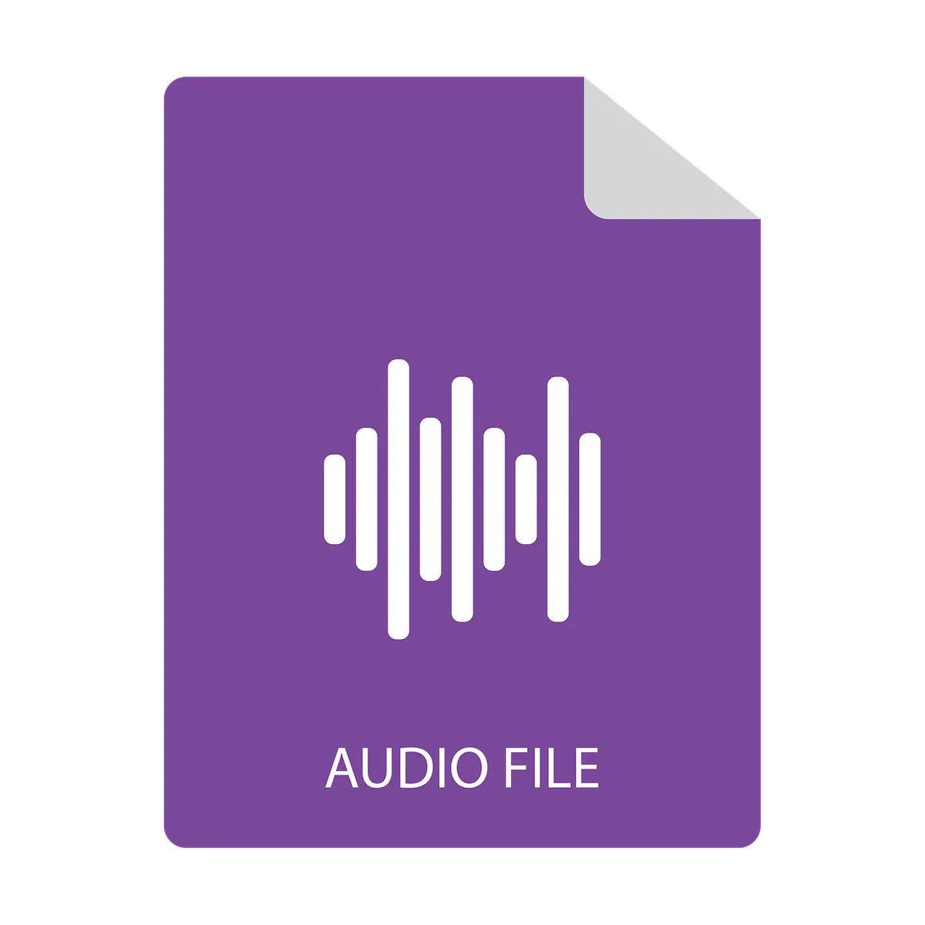
Audiophile ≠ Audio file

Slide 4












Slide 5

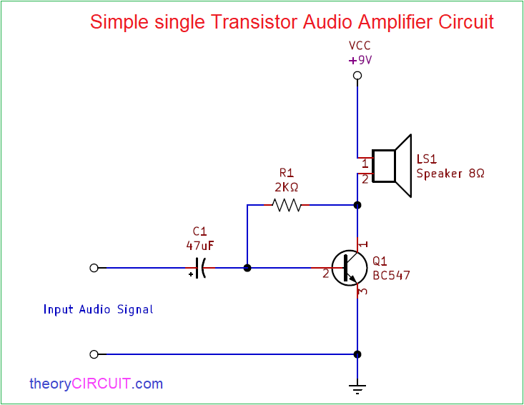
Next weekend!

Slide 6
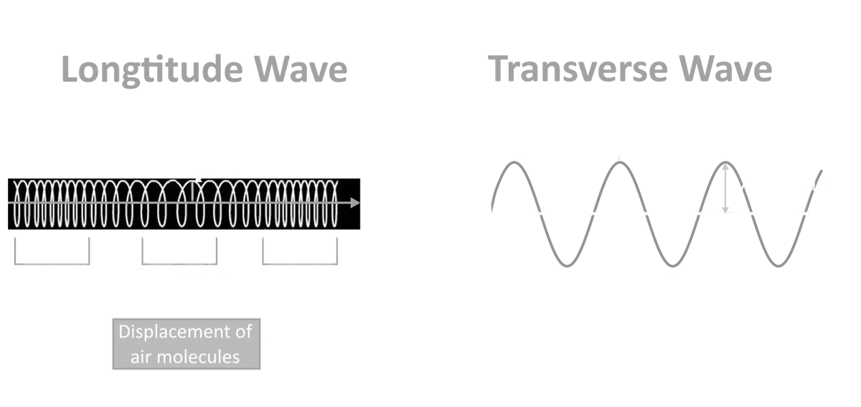
What are sound waves?

Slide 7
Topics Agenda
Software Skills
Digital vs. Analog Audio
Basic Signal Processing
Basic digital control system
Downloads
Background
Audio Effects
Around the DAW
Exercises

Slide 8
Getting Started
LMMS (Linux Multimedia Software) is a DAW (digital audio workstation).
DAWs are used in order to layout, mix, and master audio, most typically for music tracks.
These programs have built in DSP algorithms and are a great application of both electrical/computer engineering as well as computer science.
Besides LMMS, there are more popular and more powerful DAWs such as FL Studio, Ableton, Logic Pro, Cubase and so on.

Slide 9
Download LMMS
Github: https://github.com/LMMS/lmms
Download: https://lmms.io/
https://www.reddit.com/r/lmms/comments/npa9co/i_programmed_some_lmms_sample_track_upgrades_so/

Slide 10
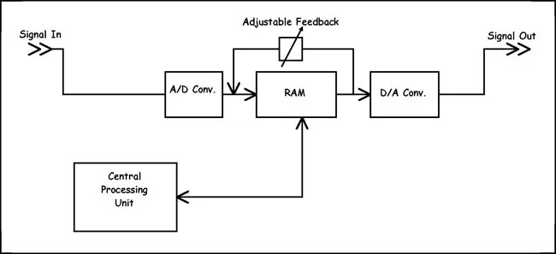
Background
DSP
Sampling
FFT
Codec
binary format
Audio Effects
EQ
Saturation/Distortion
Compression
Reverb
Limiting/Clipping
Panning
Delay
Chorus
Controls
Automation clip
LFO

Slide 11
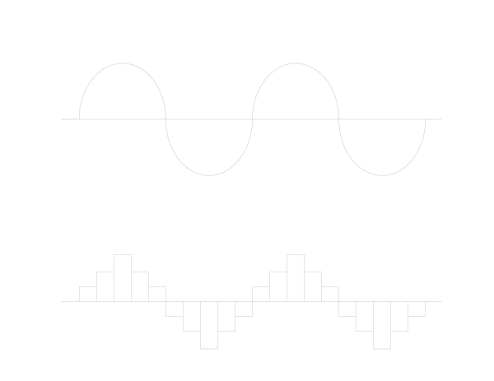
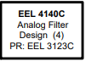
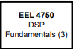
Digital Audio: Not perfect, but good enough - human ears typically don’t notice the difference

Slide 12
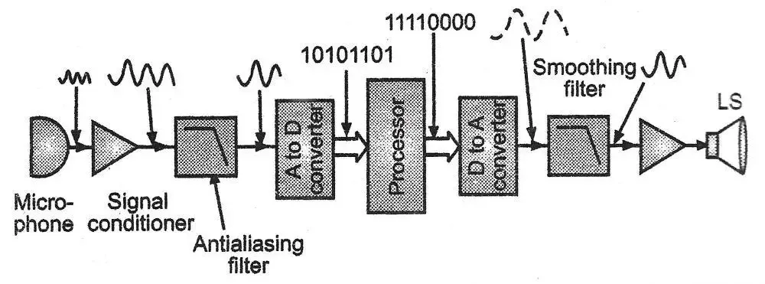
DSP (Digital Signal Processing)
Conducting mathematical manipulation on a waveform stored digitally.

Slide 13
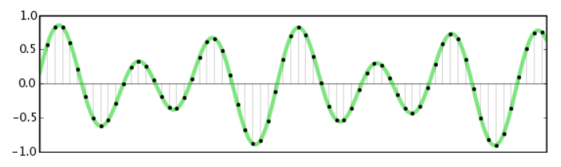
Sampling
Picking even time intervals to collect data, thus capturing the essence of the wave. Higher frequency -> more detailed digital representation of an analog wave.
Nyquist-Shannon Sampling Theorem / Nyquist Frequency

Slide 14
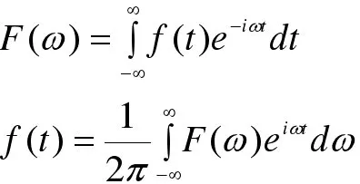
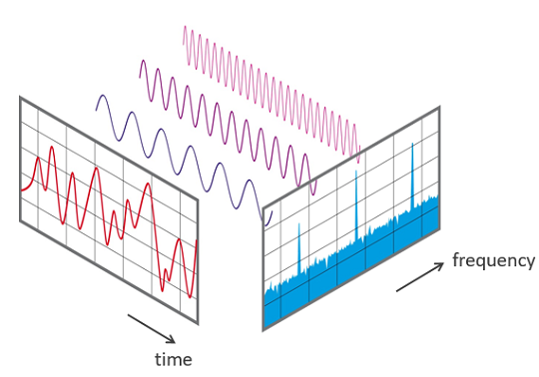
Fourier Transform/FFT
FFT essentially converts time signals to the frequency domain (or reverse), allowing them to be analyzed with our SPAN VST.
Fourier Transform is a function, but FFT is more like an algorithm.

Slide 15
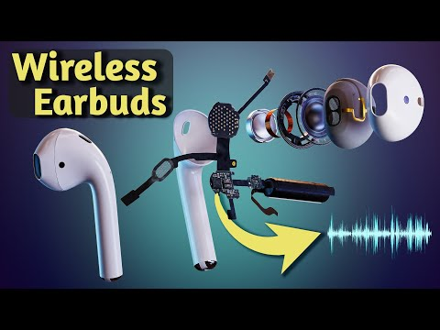
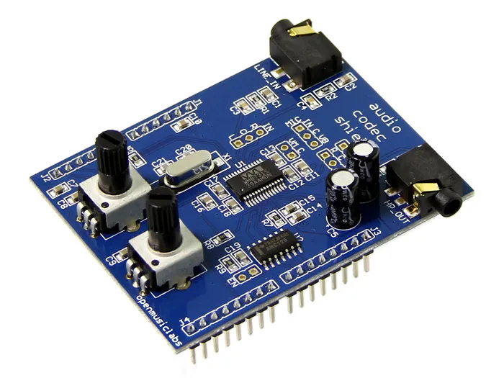
Codec
Encodes/decodes audio data to and from digital format (see next slide)

Slide 16
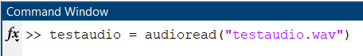
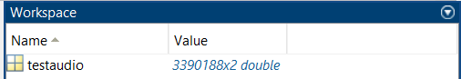
Raw Audio Format
MATLAB is now offered to UCF Students free!
A quick way to view the digital audio is this function:
Can you guess why there are 2 columns of data?

Slide 17
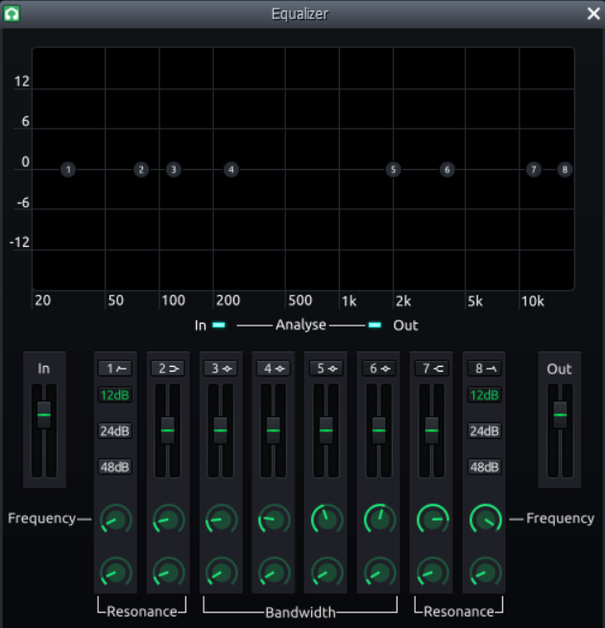
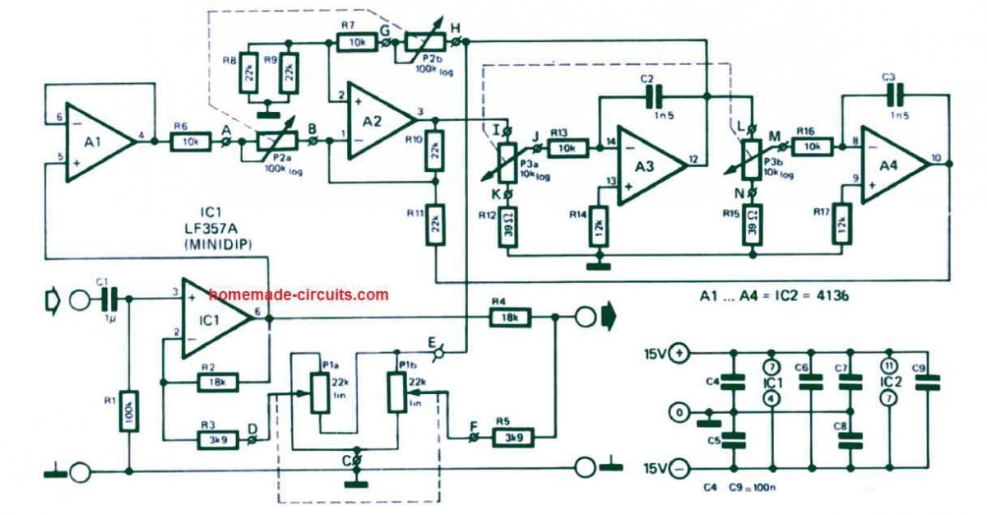
Equalizer (EQ)

Slide 18
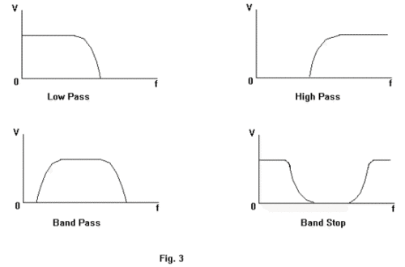
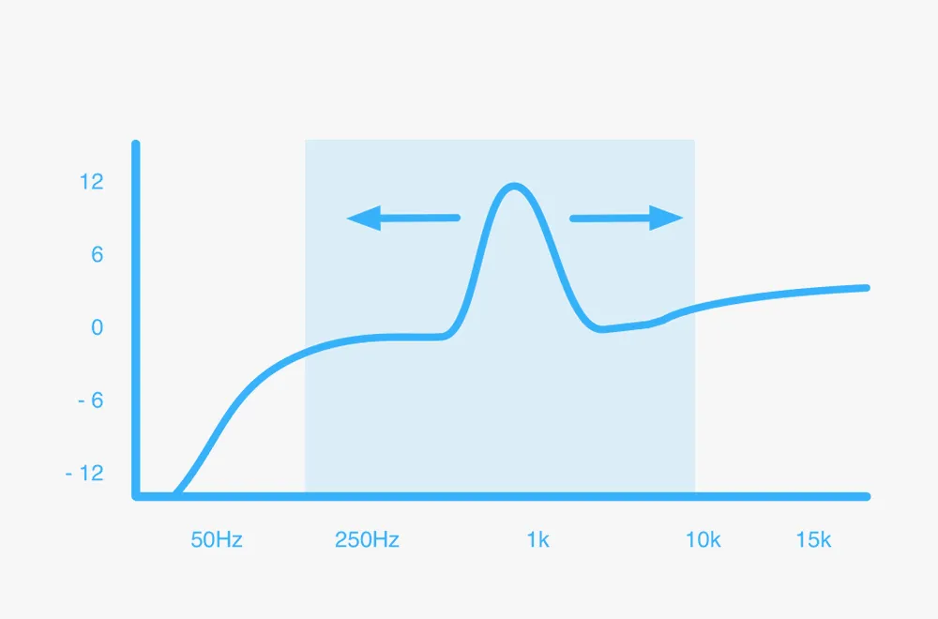
Filtering/EQ Techniques
< Filters from LC2
Frequency sweeping (search for resonance)

Slide 19
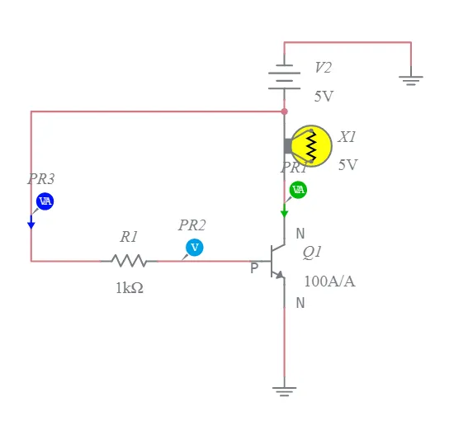
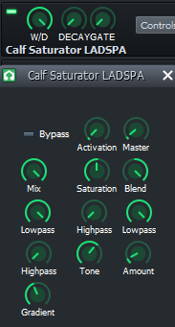
Saturation
A subtle form of distortion that adds pleasant harmonics, warmth, and color to a signal.
Driven through Tape, Tube, or Transistor

Slide 20
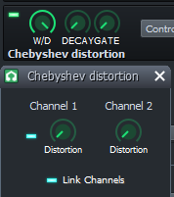
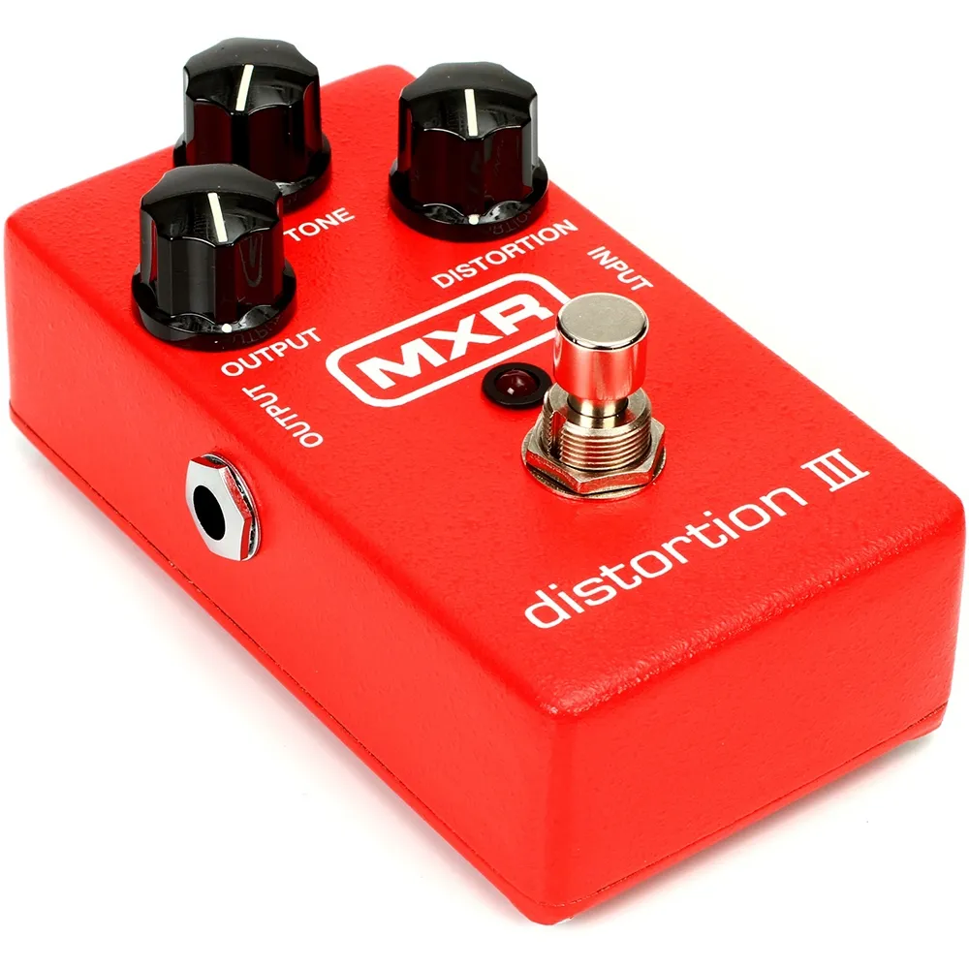
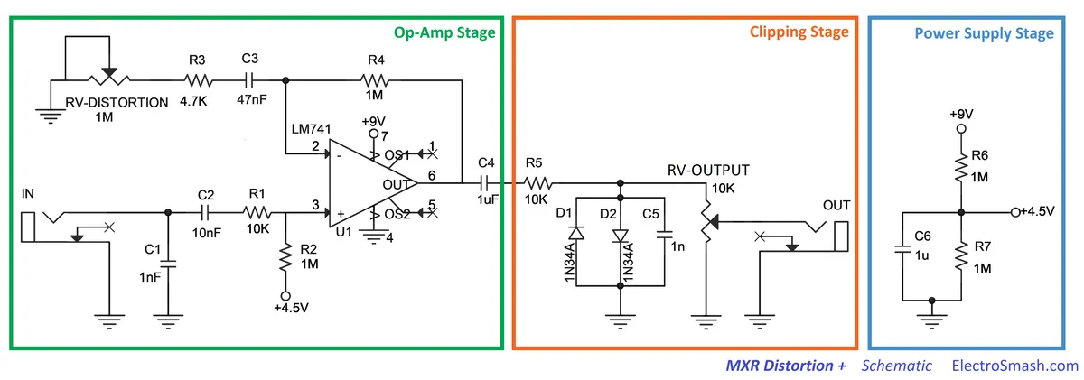
Distortion/Overdrive
Increases gain and adds a fuzzy, gritty tone.

Slide 21
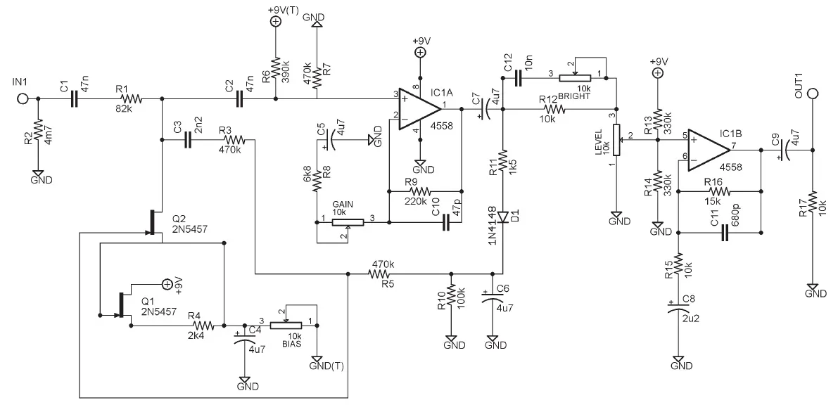
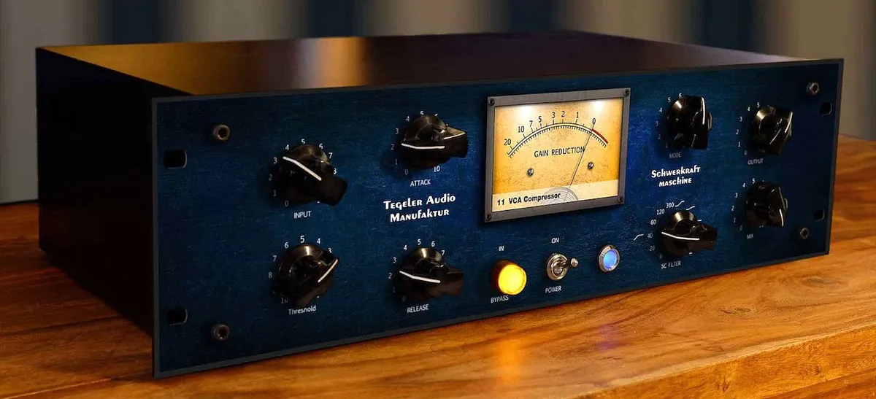
Compression
We downloaded a compressor (see later slide)

Slide 22
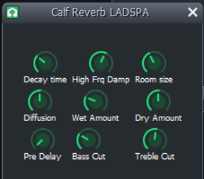
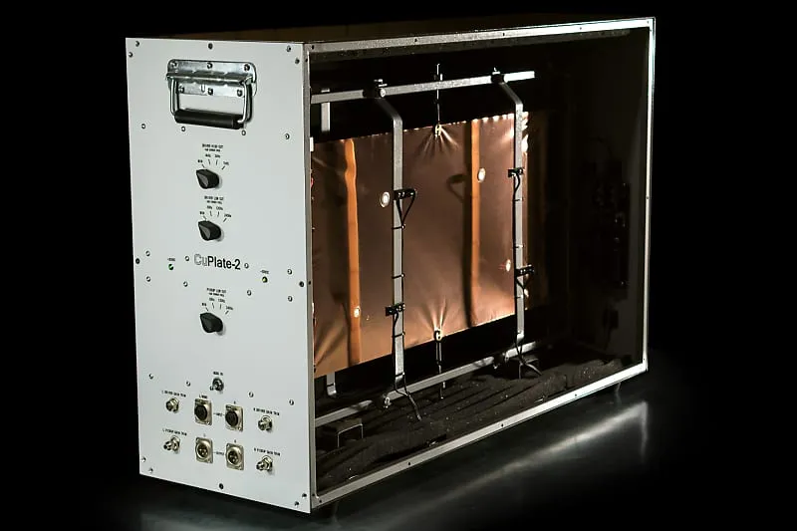
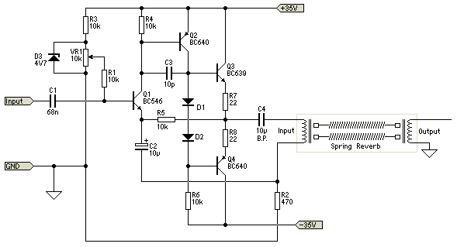
Reverb
Many types: plate, spring, digital, etc

Slide 23
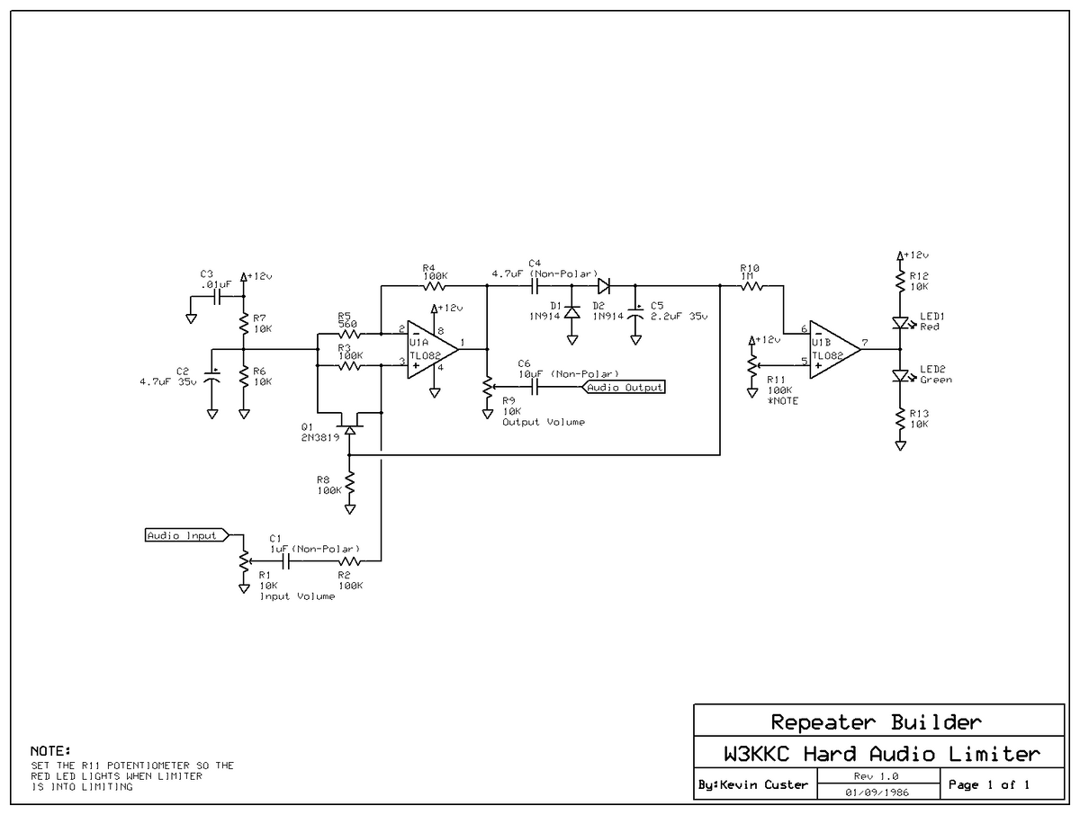
Limiter
Attenuates peaks of signals that exceed a threshold, similar to compression.
Clipping is the most unforgiving form of limiting.

Slide 24
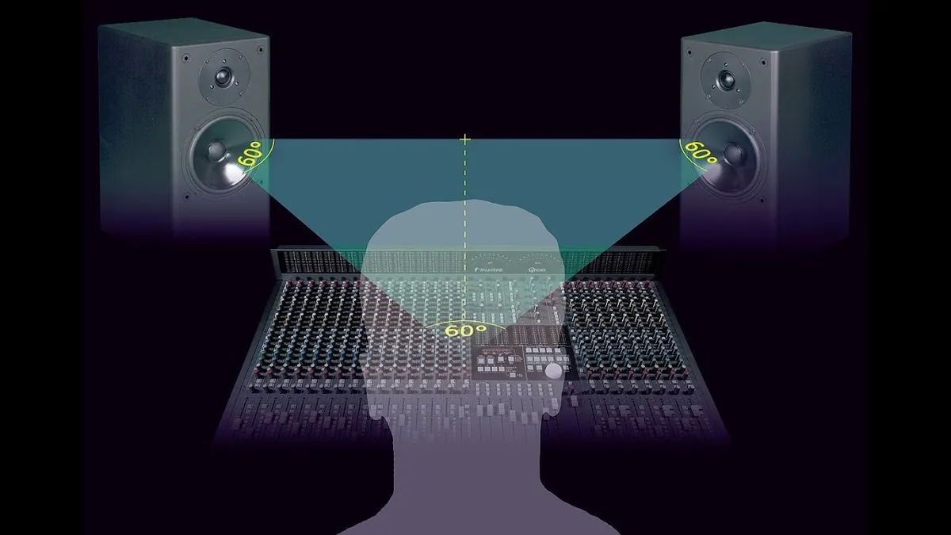
Panning
Distributes audio signal throughout stereo image.
Bonus VST Download:
https://www.izotope.com/en/products/ozone-imager.html

Slide 25
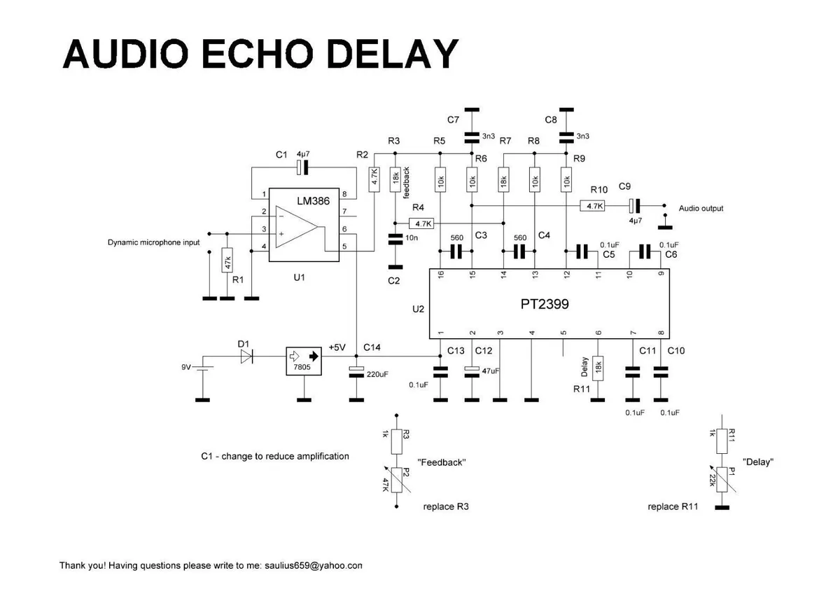
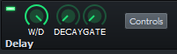
Delay
Input signal stored and played back, usually with a repetitive pattern that fades out gradually.

Slide 26
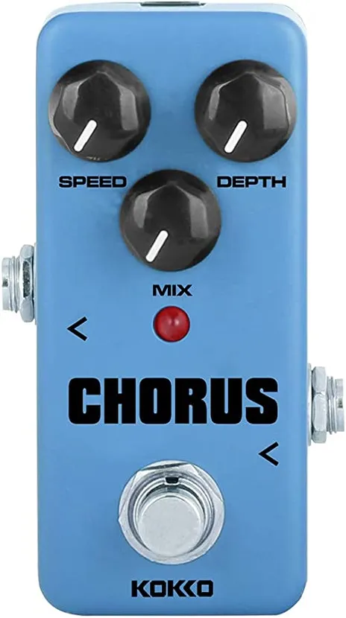
Chorus
Signal mixed with delayed copies of itself, each having slight variation. Produces a grouping/duality effect.

Slide 27
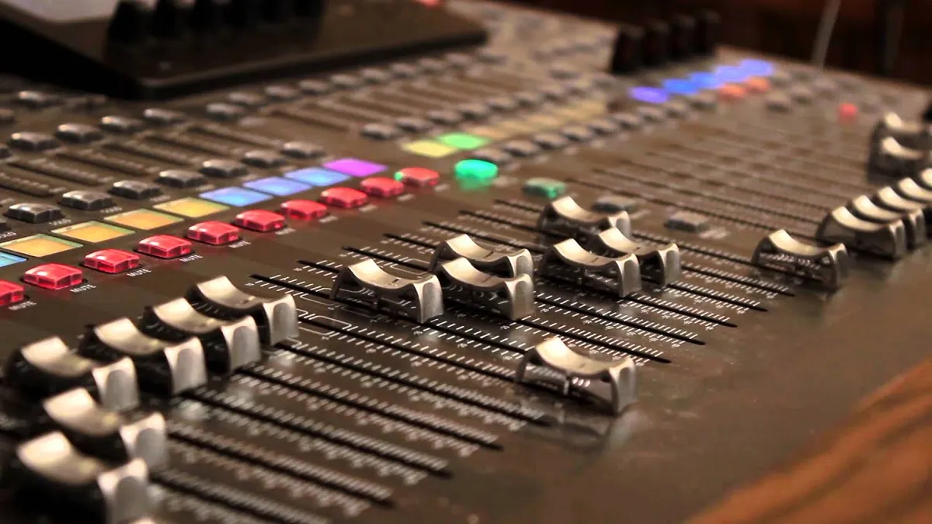
Automation
Controlled autonomous movement of faders over time

Slide 28
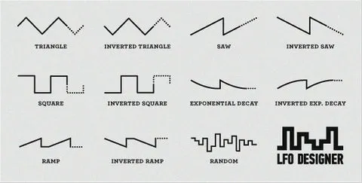
LFO - Low Frequency Oscillator
Changing a parameter over time, but with the pattern of a wave itself

Slide 29
Around the DAW
Beat/bassline editor
Piano Roll
Mixer/Effect Rack
Controller Rack
Song-editor/Playlist
Directories
Preferences

Slide 30
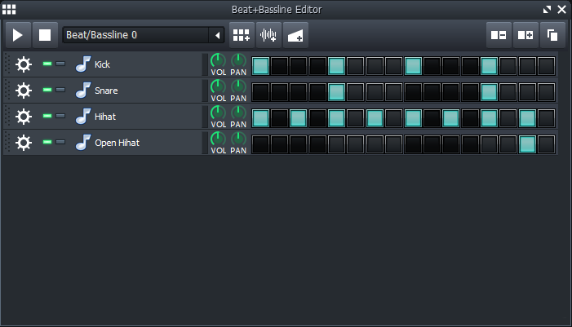
Beat and Baseline Editor
The beat and baseline editor acts as a sequencer for audio snippets. Good for making patterns.
Kind of a blackbox mentality in analog design.

Slide 31
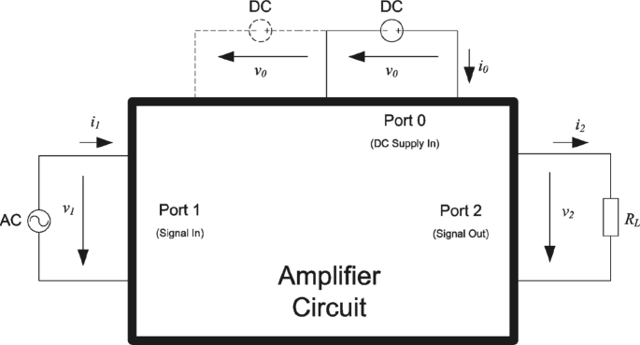

Slide 32
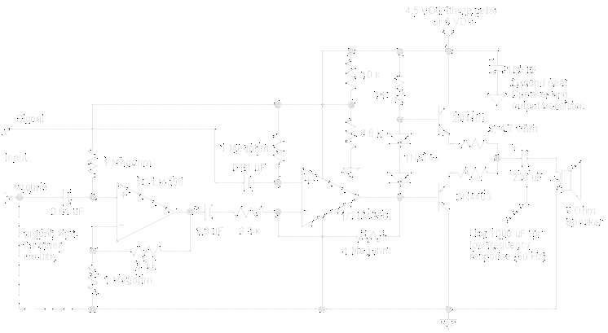

Slide 33
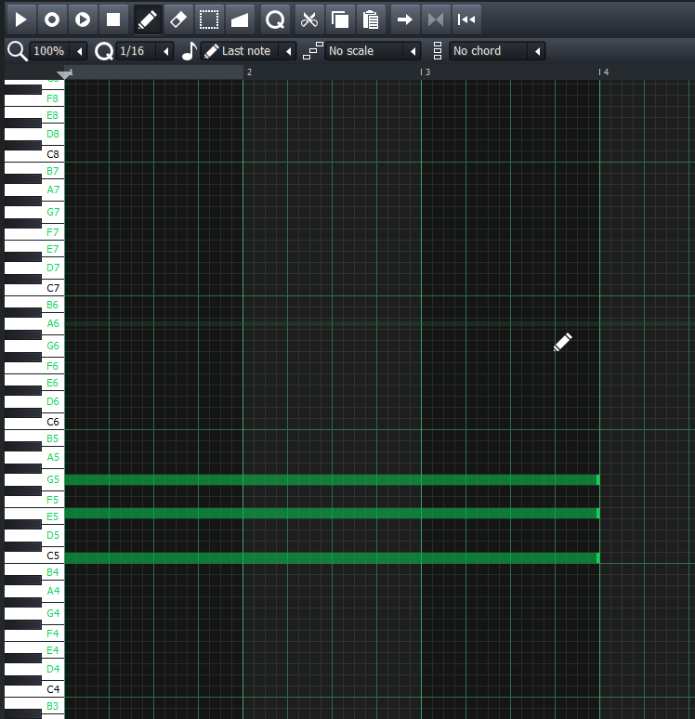
Piano Roll
Allows user to trigger a synth or sample at different pitches in order to create patterns.

Slide 34
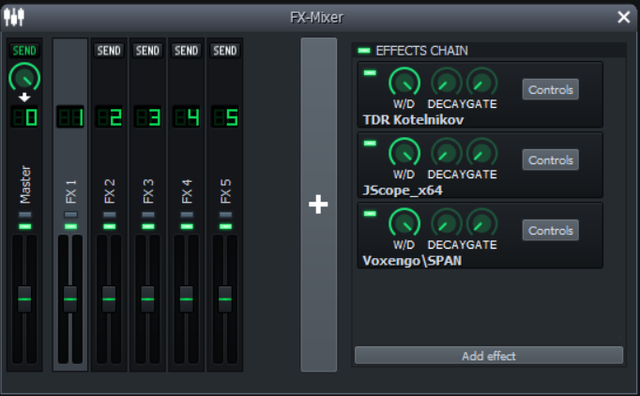
Mixer/Effect Rack
The mixer/effect rack is where signals are routed to for alteration. FX channels are automatically routed to Master. You can apply effects on a chain for each track including master.

Slide 35
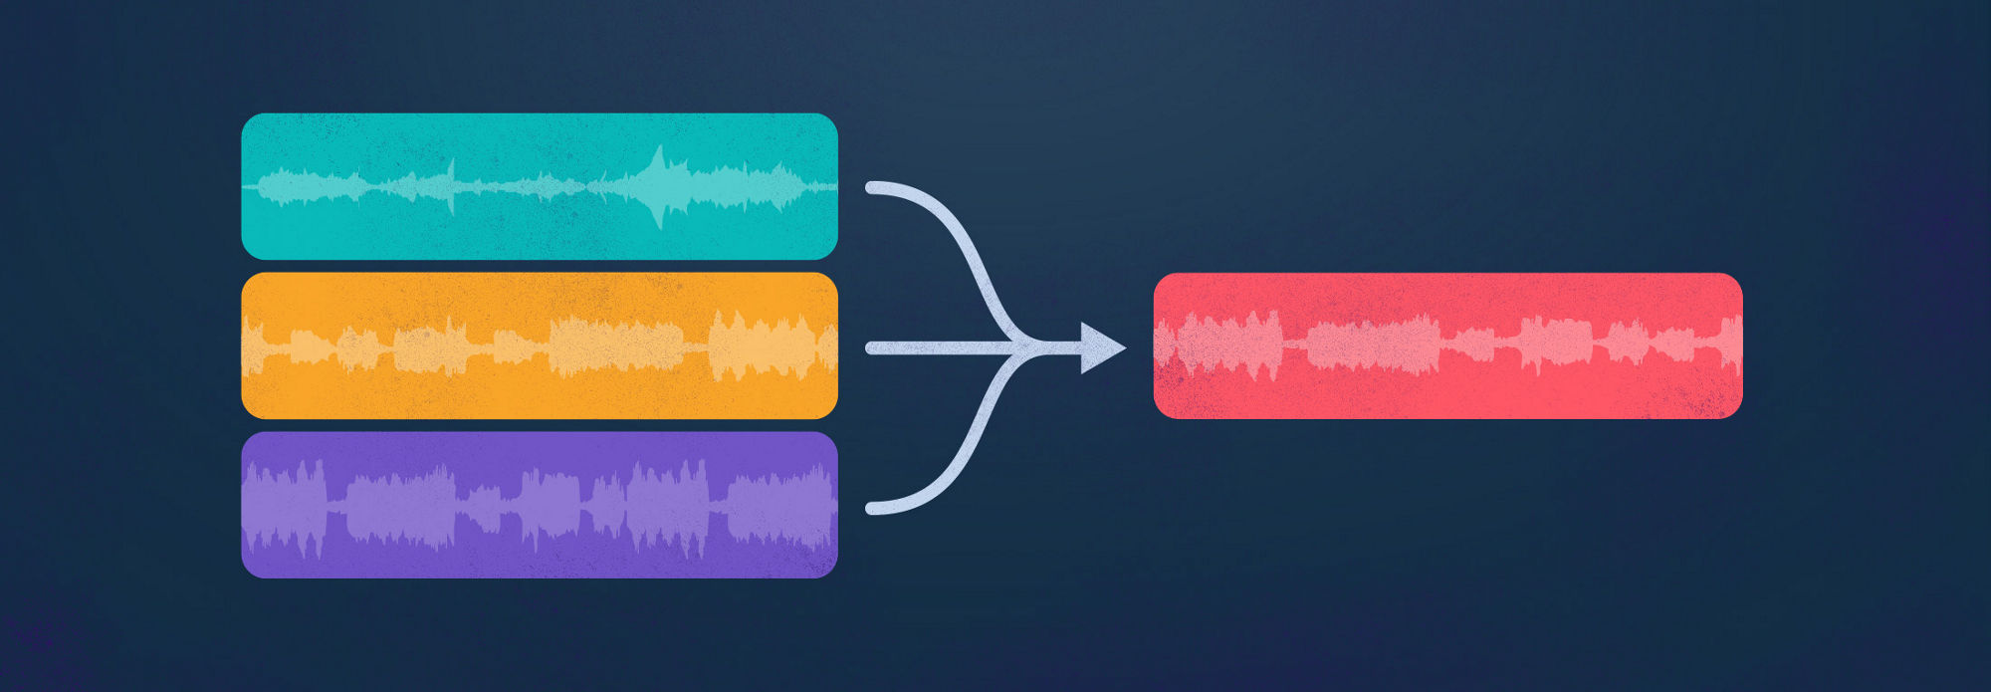
Creating a bus
Not supported in this software! More advanced DAW needed. Re-routes signals to another channel before sending to master.

Slide 36
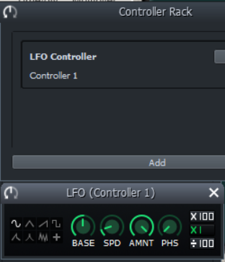
Controller Rack
Allows user to control things using an LFO (low frequency oscillator)
Right click on a knob or fader -> connect to controller
Cleaner approach than automation clips, but can be harder to keep track of!

Slide 37
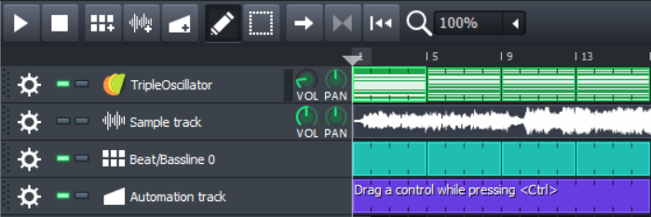
Song Editor
In other DAWs this is called the playlist.
Layers channels for simultaneous playback.

Slide 38
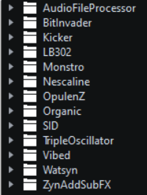
File Library
Tends to be located on the left side of the screen for many softwares.
Find and import samples, presets, VST.
Configuration and organization are important.

Slide 39

Synthesizer
virtual subtractive-synthesis-approach softsynth

Slide 40


Samples
File Explorer (Library)
Audio Processor Window

Slide 41

Routing to the mixer
Gainstaging

Slide 42

Exporting
Good software habit: save your files so you don’t lose progress if the program crashes!
Ctrl+E
Ctrl+S

Slide 43
Keyboard Shortcuts
Ctrl+A
Shift+arrow
Ctrl+C/V/X
Ctrl+drag (automation clip)

Slide 44

VST Plugins
A VST (Virtual Studio Technology) plugin is an add-on audio software. This will connect to your DAW and allow for synthesizing, mixing, or mastering.
There is a HUGE market for designing and collecting VST’s.
Next IEEE Project?

Slide 45
Additional Downloads (FREE)
Frequency Analyzer: https://www.voxengo.com/product/span/
Compressor: https://www.tokyodawn.net/tdr-kotelnikov/
Oscilloscope: http://jaggedplanet.com/VST/jscope.asp
Make sure to add the folder where you store these to your LMMS search path
Better plugins do not guarantee a better result compared to stock!

Slide 46

SPAN (Frequency Analyzer)
SPAN shows the frequency spectrum and metrics about the waveform over time.
RMS: more or less average signal power (dB)
Max Crest Factor = peak RMS - RMS
Correlation Meter shows how in/out of phase the R and L channels are (-1 out of phase, +1 in phase)

Slide 47

TDR Kotelnikov (Compressor)
Output = (Input - Threshold) / Ratio + Threshold
Compression essentially squashes a waveform so that there is less difference between the loud (high energy) and quiet (low energy) points.
Attack/Release (effect activation time)
Out Gain (re-adds dB to output signal)

Slide 48

J-Scope (Digital Oscilloscope)
Waveform visualizer
DC or AC Coupling https://www.sweetwater.com/insync/dc-coupled/
Gain/Time/Multiplier
Mode can view R and L separately
Freeze

Slide 49
now to the workshop portion!

Slide 50

Exercise 1: Mixing Multiple Channels
Apply a Hard Limiter to the master channel
Create at least 3 instances of triple oscillator and layout patterns in piano roll, lay them out in playlist or beat&bassline editor
Route each instance to a new mixer channel
Apply equalizer to each mixer channel
Add a highpass, lowpass, and bandpass EQ to the different channels
Apply SPAN to the master channel and listen to the waveform. Try disabling the EQ’s. Does it sound the same?

Slide 51



Exercise 2: Automation & Control
Click inside a grid space for an automation clip
Hold Ctrl+click and drag a knob and drop on top of the purple box
Double click the box to open it
Click and drag points to create a slope
You could try automating the EQ cutoff frequency, or the volume of faders. This is how sweeping and fading in/out is done in music production.

Slide 52

Exercise 2: Low Frequency Oscillator
Right click on a fader and select
Open the controller rack
Add a controller and open the controls
Choose the oscillation pattern and tweak other knobs to your liking
Play the audio and listen to the output.

Slide 53
Exercise 3: Fill the Frequency Response (Reverse Engineer)
Goal: given the frequency response, recreate it using triple oscillator
Harmonics are magic.
Easy - Medium - Hard difficulty

Slide 54

Easy
Notes:
C4 sine wave

Slide 55

Easy
Notes:
E4 E8 sine

Slide 56

Easy
Notes:
C1 C8 E8 sine wave

Slide 57

Medium
Notes:
Dmaj 7 sine

Slide 58

Medium
Notes:
Dmaj9 saw

Slide 59

Hard
Notes:
C4 E6 G6 sine + C6 saw

Slide 60


One more trick: Denoising in Audacity
Effect -> Noise Reduction -> Acquire Noise Profile
Select all -> Effect -> Noise Reduction -> Reduce noise

